Slide 1
WebView

Slide 2
WebView - Widget
A WebView is often used to load HTML content within a native application.
The WebView is capable of displaying online or offline web content within its layout using HTML5, JavaScript, and CSS technologies.
It also includes standard browser features like history, zooming, JavaScript, rendering CSS, and so on.

Slide 3
Algorithm.
Create a WebView widget in xml file.
Declare and initialize webview.
Add permission to access Internet.
Enable Javascript through settings.
Add ShouldOverrideUrlLoading method for link forwarding in same view.

Slide 4
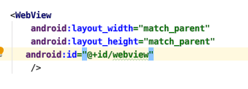
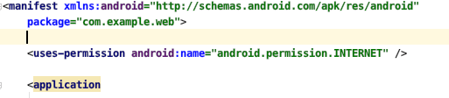
WebView Widget
.Manifest file

Slide 5


Declaration and Initialization WebView
Enabling JavaScript & Loading webpage

Slide 6
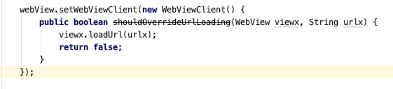
Link Forwarding on same WebView

Slide 7
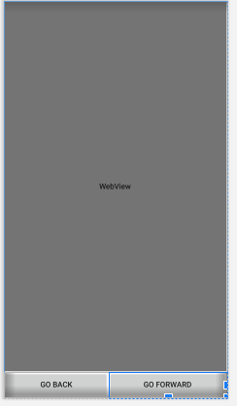
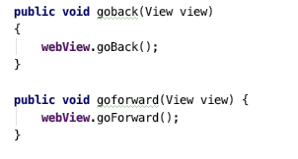
GoBack and GoForward and refresh()

Slide 8
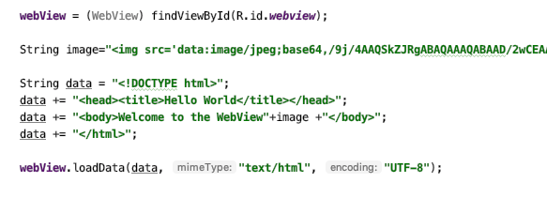
Loading HTML in WebView

